Slide 1

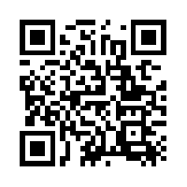
Quantum Communications Group
Weekly report
Group Coordinator:
Armando Nolasco Pinto
anp@ua.pt
Diogo Matos - 10/10/2023
Group Websites:
https://www.it.pt/Groups/Index/72
LinkedIn: https://www.linkedin.com/company/quantum-communications-group-it-av/

Slide 2

ICFO raw keys test
Files with in-phase and quadrature components for Bob and Charlie;
After loading each raw key has 20MB;
QBER = 0.432;
I was able to create valid oblivious keys from the raw keys.

Slide 3
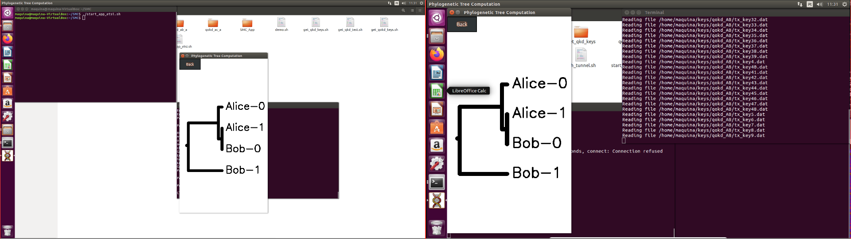
Genome app
Compilation & setup script;
ICFO keys test:
Keys created locally were giving errors, most likely because of the length of the keys per file;
Keys created using directly the machines running the app, were verified successfully and work properly in the QSMC

Slide 4
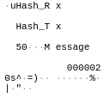
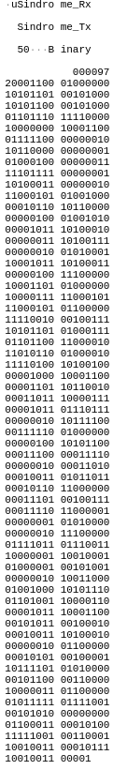
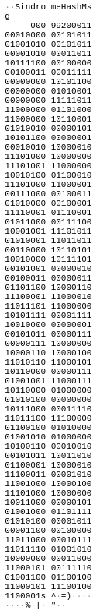

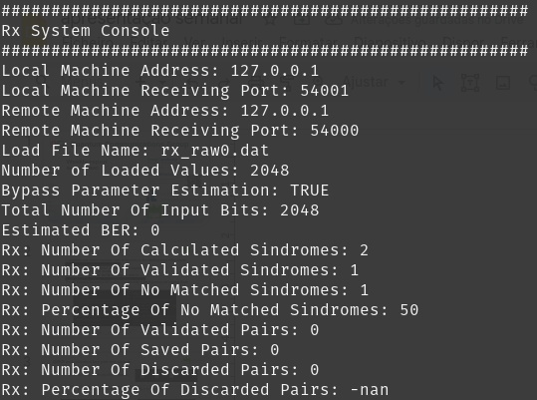
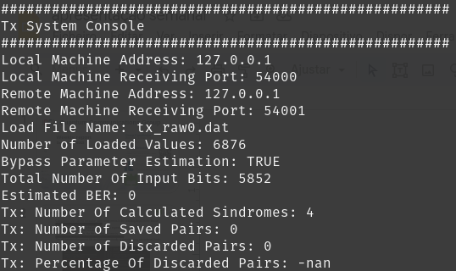
Cv qokd ldpc new message handler
The message handler are replacing the processor_transmiter/receiver that have inselfs some logic associated with message type;
Sindrome_hash messages are being divided since into two messages. A bundle functionality in the message_handler was added;
Síndrome reconciliation module is not sending expected output signal;
The solution was to use the messageHandler to encapsulate the messages. Gives the ability to add more modules and use the message handler to route their messages.
Hash msg
Expected msg from Tx to Rx
Rx freeze
Tx freeze
Síndrome msg
Expected msg

